Slide 1
NDA Annual Conference 2020

Slide 2
Access and participation issues in Court Modernisation Processes and Digital Justice

Slide 3
About the EHRC
National Equality Body
National Human Rights Institution
GB remit
Power to conduct inquiries
Inclusive Justice: a system designed for all

Slide 4
Our inquiry
Disabled people’s experiences in the criminal justice system
Defendant’s perspective
Pre-trial stage
England, Scotland and Wales

Slide 5
Access and participation
Identifying defendants’ needs
Making adjustments to meet needs
Full participation in proceedings
Impact of court modernisation and digital justice

Slide 6
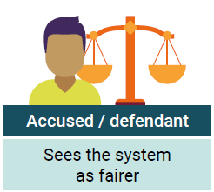
Benefits of effective participation

Slide 7
Key recommendations
Liaison and Diversion services; universal screening
Information sharing
Registered intermediaries
Accessible information and mechanisms to raise issues
Identify where video hearings are unsuitable
Collection, monitoring and analysis of data

