Slide 1
NDA Annual Conference 2020

Slide 2
People with Intellectual Disabilities in Irish Prisons: Could Article 13 Hold the Key?
Gautam Gulati MD
NDA Annual Conference, 21st October 2020

Slide 3
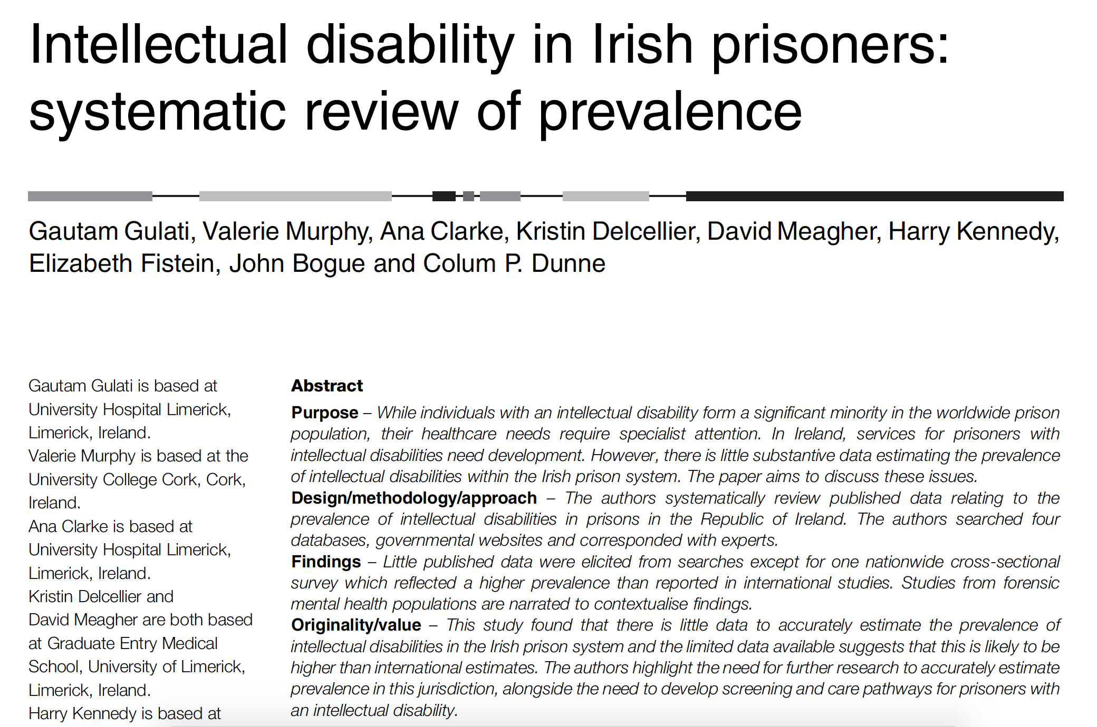
Article Intellectual disability in Irish prisoners

Slide 4
Abstract International Journal of Law and Pscyhiatry

Slide 5
Abstract from Journal

Slide 6
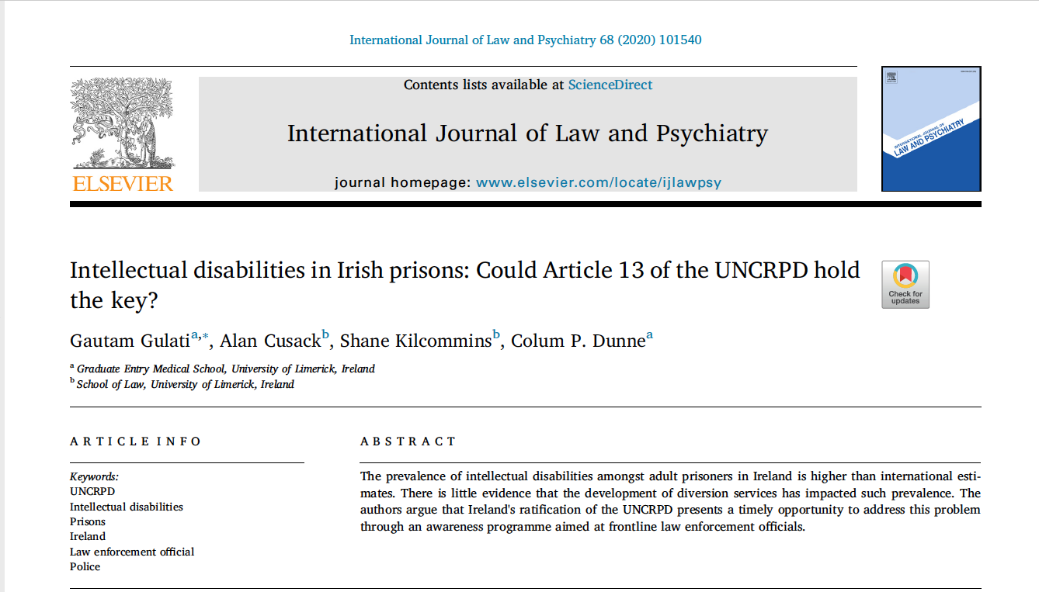
Abstract International Journal of Law and Psychiatry

Slide 7
Summary
Prevalence of People with Intellectual Disabilities in Prison
Views of People with Intellectual Disabilities
Views of Police Officers
Article 13 of the UNCRPD

