Slide 1
NDA Annual Conference 2020

Slide 2
Toward Trauma Responsive Custody: Supporting Mental Health
Dr Maggie Mc Govern
Senior Psychologist
Irish Prison Service

Slide 3
What do we mean by Mental Health?
Centre for Mental Health 2017

Slide 4
Mental Health in Prison
Research is consistent:
Higher prevalence of mental health difficulties
Higher rates of learning and communication difficulties and addiction problems
(Durcan & Zwemstra, 2014)
Complexity is typical, co-morbidities expected
Mental health concerns present alongside several other concurrent vulnerabilities (Durcan, 2008)
Addiction/problematic substance use
Learning difficulties/disabilities
History unemployment
Limited education
Unstable housing
Debt (inside and outside prison)
Poor general health
Trauma
Limited life and social skills

Slide 5
Mental Health in Custody
90% of prisoners suffered from a mental illness, addiction or a personality disorder
70% of prisoners had two or more such problems
(Large Scale UK Study 3000⁺ interviews : Singleton, Meltzer, Gatward, 1998)
Rates of Personality Disorder of particular note:
4-11 % of general population
60 – 70% prison population
Historically seen as ‘untreatable’
Trauma
Excluded from ROI Mental Health Act (2001)

Slide 6
Seeing the Individual
Individualised approach essential
Health and care needs
Assessment and management
Gatherer, Ataby, Hariga, 2014

Slide 7
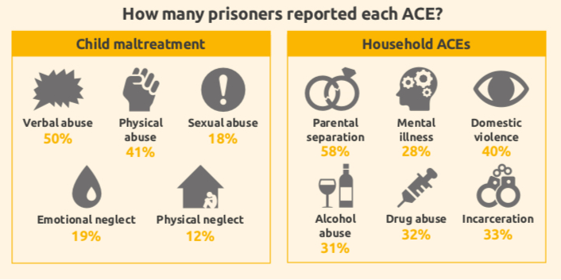
Seeing the Bigger Picture
Adverse Childhood Experiences and Trauma: 468 MALES Welsh Prison (Ford et al., 2019)

Slide 8
Seeing the Big Picture
Women in custody: up to 90% have experienced physical or sexual violence
↑ ACES - ↑ risk of poor health
including mental illness, early development of chronic health conditions, premature mortality, addiction, poor educational attainment, violence and crime
4 or more ACEs - 15 times more likely to have perpetrated violence in the last year
- 20 times more likely to be incarcerated
Exposure is higher among people with intellectual disabilities when compared to peers without such disabilities
A prison problem? A public health issue?
(Feletti, 1998)
(Ford et al., 2019)
(Wigham & Emerson, 2015)
(Saavkvine, 2013)

Slide 9
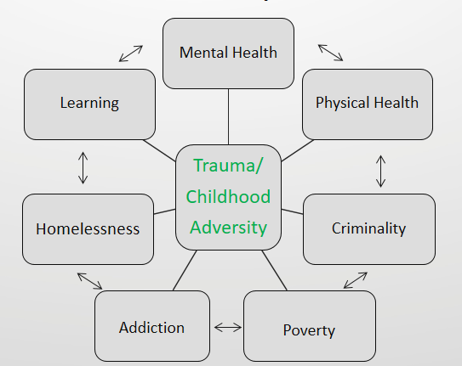
Dose-Response
Correlation not causation:
The interface between nature and nurture: epigenetics, neurobiology and stress
Behavioural Biology: Sapolsky

Slide 10
Prison & Trauma
While many benefit from basic prison care as well as specialist intervention
(Gatherer, Ataby, Hariga, 2014)
Risk of re-traumatisation and exacerbation of mental health and other difficulties
Challenging environment
Vulnerability to humiliation and violence- over-crowding of concern (Gatherer, Ataby, Hariga, 2014)
Prison is for ‘perpetrators’? (Miller & Najavits, 2012; Widom & Maxfield, 2001)
Imprisonment of people with severe disabilities and ill health
Diversion and coordination of care with community and specialist services
UN Convention on the Rights of Persons with Disabilities (CRPD)

Slide 11
Trauma: Problematic Coping
Coping strategies:
At one point, they were effective
In some settings they are effective
People need to learn new strategies but no one can learn when on high alert
Prison can be a place to learn and practice new coping strategies
Trauma need not, and does not define a person
McKechnie, 2014

Slide 12
A Trauma Informed System
realizes the widespread impact of trauma and understands potential paths for recovery;
recognizes the signs and symptoms of trauma in clients, families, staff and others involved within the system;
responds by fully integrating knowledge about trauma into policies, procedures, and practices,
seeks to actively resist re-traumatisation.
SAMHSA JULY 2014

Slide 13
Trauma Informed & Trauma Specific
Safe
Predictable
Calm
Trusting relationships
Opportunity to try new things
Understanding
Lack of judgement
Targeted Supports and Interventions:
Learning Environment:
Psychology
Forensic Mental Health Team (Psychiatry)
Addiction Services
Specialist Counselling (eg. sexual trauma)
Probation Services
Self-Development Programmes & Peer Lead Support Services
Investing in Community Step-Downs and Supports
Education and Training

Slide 14
Six Principles of Trauma Informed Approach
Safety
Trustworthiness and Transparency
Peer Support
Collaboration and Mutuality
Empowerment, Voice and Choice
Cultural Historical and Gender Issues
Making it meaningful..
(Jewkes et al., 2019).

Slide 15
IPS Psychology Service Strategic Actions 2019-2022
Porporino (2015) recommendations:
Establish a multi-disciplinary model of mental healthcare
In conjunction with IPS Healthcare, National Forensic Mental Health Service & Allied Services
Continue to build on best practice offence – specific interventions
Develop a best fit model of trauma informed correctional care
Interventions for prisoners who deny sexual violence
Ratios of Psychologists to People in Custody
1 : 311 (End Dec 2019)
1 : 150 (recommended)

Slide 16
Thank you

Slide 17
References & Resources
Creating trauma-informed correctional care: a balance of goals and environment; Miller & Najavits (2012) Eur J Psychotraumatol, 2012) https://www.ncbi.nlm.nih.gov/pmc/articles/PMC3402099/
McKechnie (2015) Trauma and the impact on female offending (PDF available online- helpful summary- source) Exposure to Trauma among Women Offenders: A Review of the Literature; Tam & Derkzen (2014) Correctional Service of Canada, August 2014)
Gatherer, Atabay, Hariga (2014) Prisons and health (WHO, UNODC, ICRC) Chapter 17. Prisoners with Special Needs December 2014 In book: Prisons and health (WHO, UNODC, ICRC Publisher: WHOISBN 978 92 890 5059 3 Editors: WHO
Singleton N, Meltzer H, Gatward R. Psychiatric morbidity among prisoners in England and Wales. London, Office for National Statistics, 1998.
Durcan G. From the inside. Experiences of prison mental health care. London, Sainsbury Centre for Mental Health, 2008 (http://www.centreformentalhealth.org.uk/pdfs/From_the_Inside.pdf, accessed 28 November 2013).

Slide 18
Resources
Ford, Kat & Barton, Emma & Newbury, Annemarie & Hughes, Karen & Bezeczky, Zoe & Roderick, Janine & Bellis, Mark. (2019). Understanding the prevalence of adverse childhood experiences (ACEs) in a male offender population in Wales: The Prisoner ACE Survey.
Wigham, S., Emerson, E. Trauma and Life Events in Adults with Intellectual Disability. Curr Dev Disord Rep 2, 93–99 (2015)
Jewkes, Y., Jordan, M., Wright, S., & Bendelow, G. (2019). Designing 'Healthy' Prisons for Women: Incorporating Trauma-Informed Care and Practice (TICP) into Prison Planning and Design. International journal of environmental research and public health, 16(20), 3818. https://doi.org/10.3390/ijerph16203818
Niki A. Miller & Lisa M. Najavits (2012) Creating trauma-informed correctional care: a balance of goals and environment, European Journal Of Psychotraumatology, 3:1, DOI.
SAMHSA: Substance Abuse and Mental Health Services Administration U.S. Department of Health and Human Services Guidance for Trauma Informed Approach
https://store.samhsa.gov/shin/content/SMA14-4884/SMA14-4884.pdf

